Slide 1
Substitution Matrices and Protein Alignments
BIO 300/CMPSC 300
Dr. Kristen Webb
Spring 2016

Slide 2
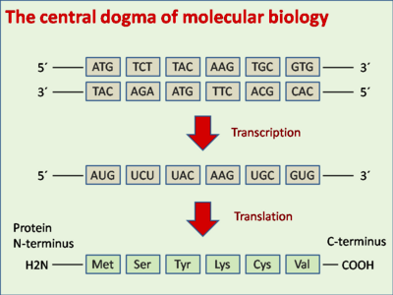

Slide 3
Protein Alignment
Redundant codons mean ~1/3 of DNA mutations often don’t alter protein

Slide 4
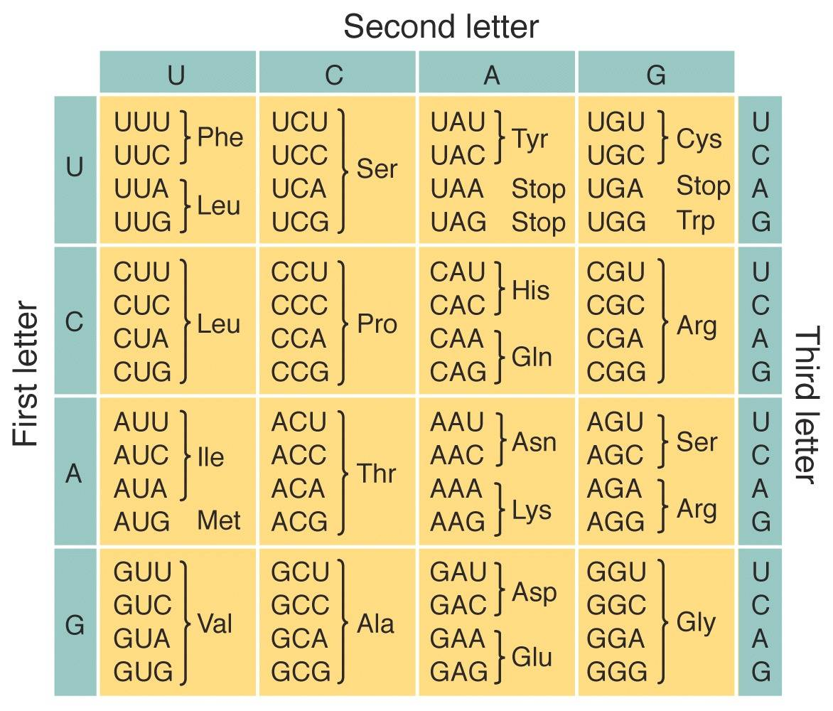
Notes:
Examples of codons from book/notes

Slide 5
Protein Alignment
Redundant codons mean ~1/3 of DNA mutations often don’t alter protein
Nucleotide alignment – misrepresentation of biological consequences

Slide 6
Protein Alignment
Redundant codons mean ~1/3 of DNA mutations often don’t alter protein
Nucleotide alignment – misrepresentation of biological consequences
Larger “alphabet” means much less likely to get a match by chance, increases statistical significance of a match
Nucleotides – 4
Amino acids – 20

Slide 7
Protein Alignment
Redundant codons mean ~1/3 of DNA mutations often don’t alter protein
Nucleotide alignment – misrepresentation of biological consequences
Larger “alphabet” means much less likely to get a match by chance, increases statistical significance of a match
Nucleotides – 4
Amino acids – 20
Not all amino acid changes are equally harmful to the protein structure
Amino acid structures

Slide 8
Amino Acid Substitutions
Nucleotides – any substitution is “different”
Amino Acids
Substituting similar ones is likely to retain protein structure and function
Substituting dissimilar ones is likely to change protein structure and disrupt function

Slide 9
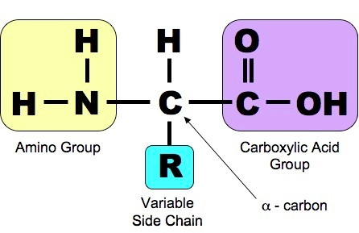
Amino Acid Structure

Slide 10
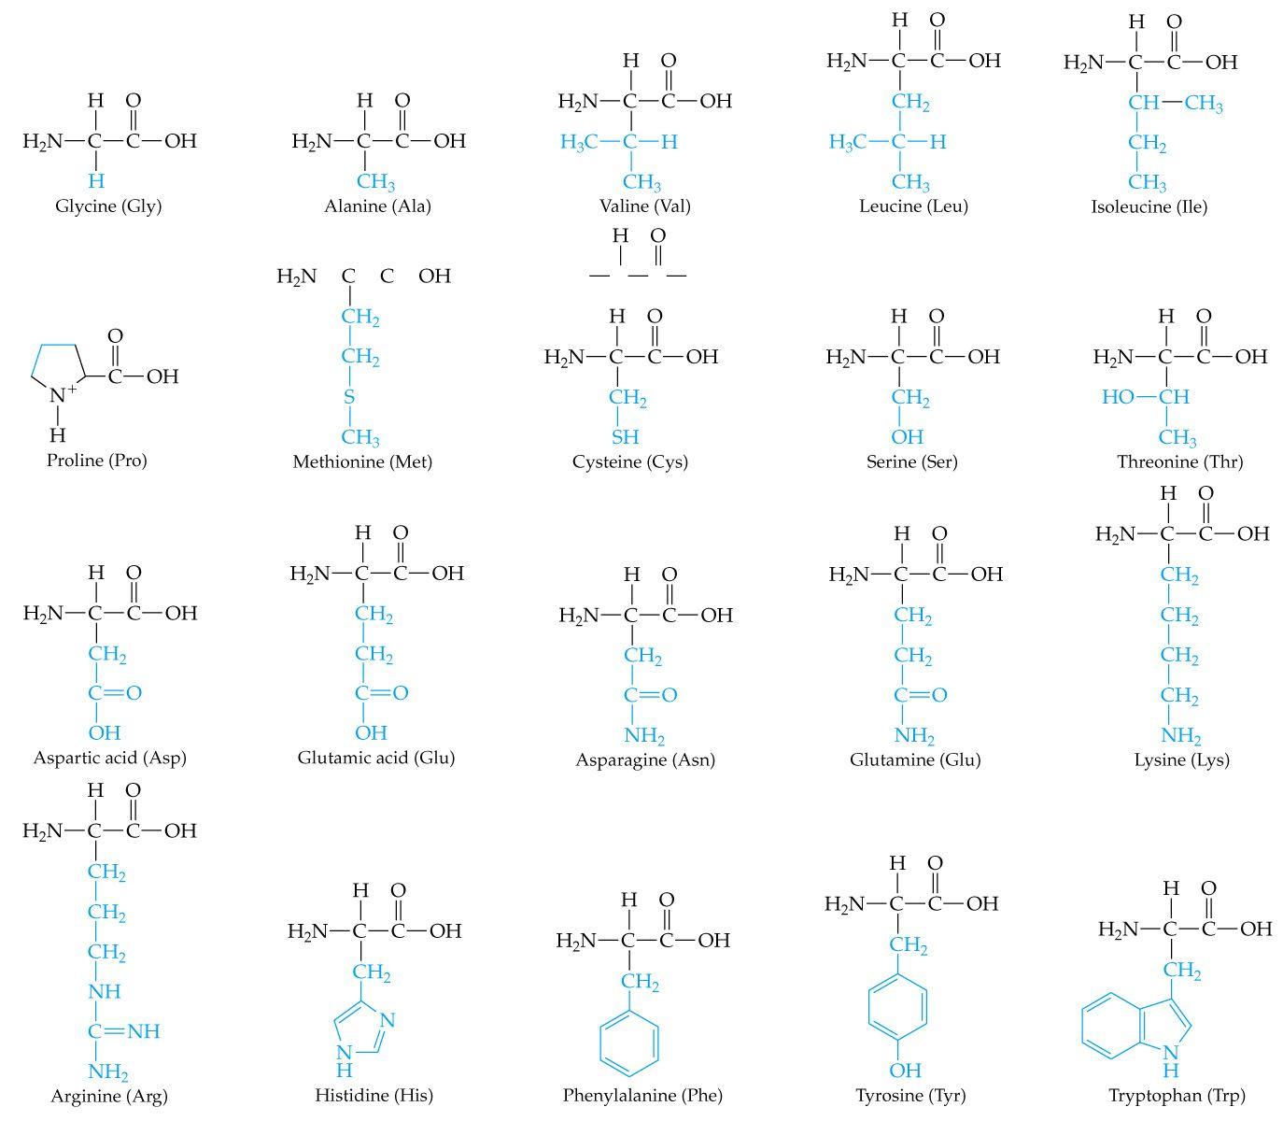
Amino Acid Structure

Slide 11
Amino Acid Substitutions
Similarity of amino acids means
Similar physicochemical properties
Physics + chemistry
Polar vs nonpolar
Hydrophobic vs hydrophilic
Positive electric charge vs negative electric charge
Aromatic (6 carbon ring)
Basic vs Acidic
http://www.bio.davidson.edu/courses/genomics/jmol/aatable.html
http://www.proteinstructures.com/Structure/Structure/amino-acids.html

Slide 12
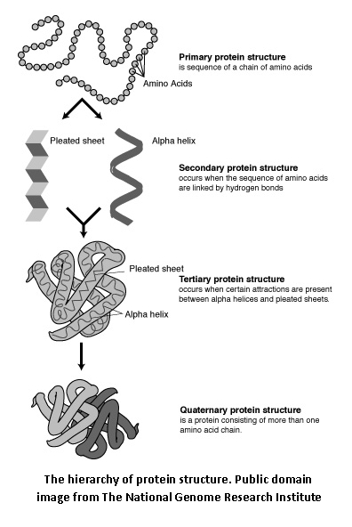
Amino Acids Determine Protein’s Shape and Function

Slide 13
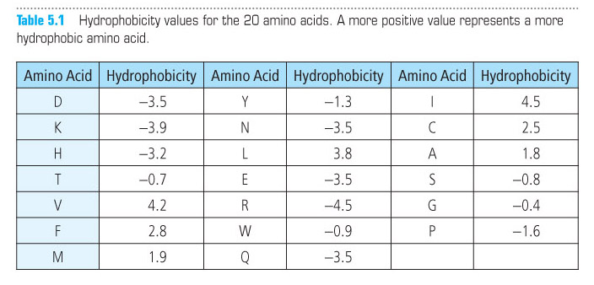
Scoring Amino Acid Substitutions
Could try to quantify physicochemical properties

Slide 14
Scoring Amino Acid Substitutions
Better to study evolution of real proteins

Slide 15
Scoring Amino Acid Substitutions
Better to study evolution of real proteins from closely related organisms

Slide 16
Scoring Amino Acid Substitutions
Better to study evolution of real proteins from closely related organisms
Minimizes likelihood that an observed difference represents a series of >1 individual mutations
Species A – Ala Species B – Ile
Ala → Ile – 1 mutation
Ala → Pro → Ser → Ile – 3 mutations

Slide 17
A Model of Evolutionary Change in Proteins Dayhoff et al., 1978
Global Pairwise Alignment
Observed frequency of each possible amino acid substitution:
10 log₁₀ (M_{ij}/f_{j})
M_{ij} - the probability of a mutation replacing amino i with j
f_{j} - the frequency of amino acid j in a large set of sequences

Slide 18
A Model of Evolutionary Change in Proteins Dayhoff et al., 1978
Global Pairwise Alignment
Observed frequency of each possible amino acid substitution:
10 log₁₀ (M_{ij}/f_{j})
Why is amino acid j in the sequence?
M_{ij} - amino acid j occurs due to evolutionary conservation of a substitution
f_{j} - j’s occurrence is random

Slide 19
A Model of Evolutionary Change in Proteins Dayhoff et al., 1978
Global Pairwise Alignment
Observed frequency of each possible amino acid substitution:
10 log₁₀ (M_{ij}/f_{j})
Odds ratio
= 1 - substitution of j for i is no more likely than the chance of finding j randomly
> 1 - substitution is evolutionarily conserved
< 1 – substitution is selected against

Slide 20
A Model of Evolutionary Change in Proteins Dayhoff et al., 1978
Global Pairwise Alignment
Observed frequency of each possible amino acid substitution:
10 log₁₀ (M_{ij}/f_{j})
log-odds ratio – easier for scoring
More positive for likely (conservative) substitutions
More negative for unlikely (non-conservative) substitutions
Multiplied by 10 and rounded to nearest integer

Slide 21
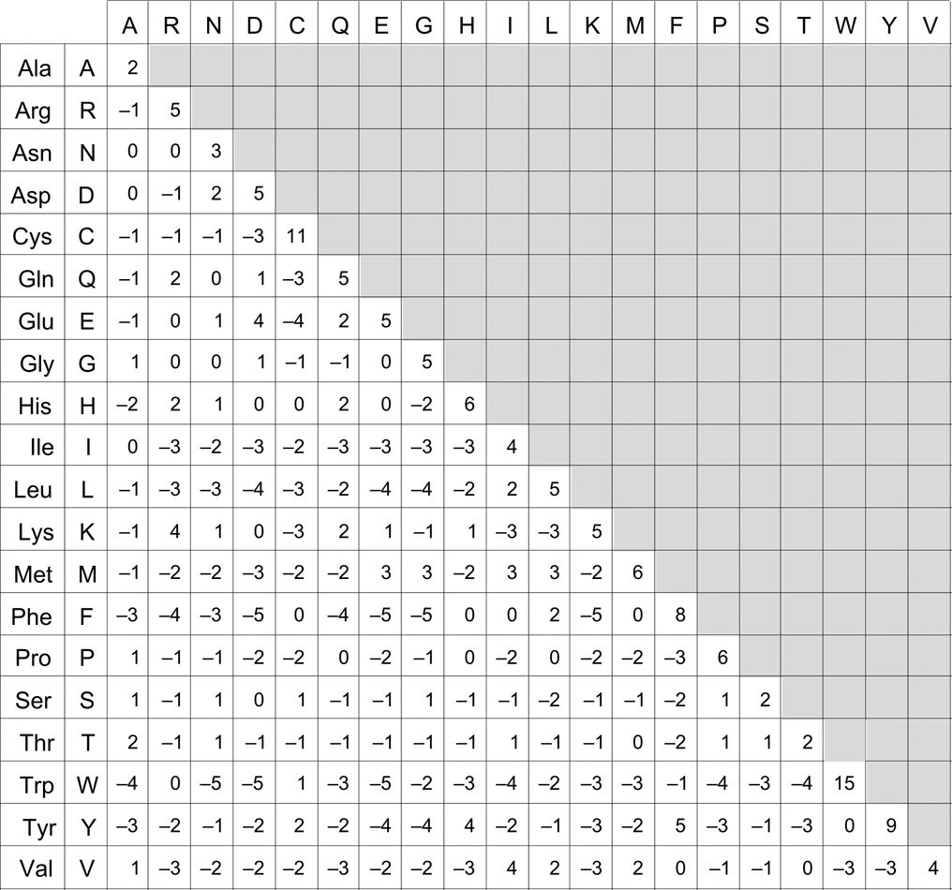
PAM matrix

Slide 22
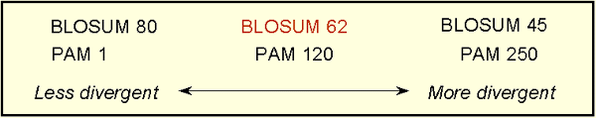
PAM matrices
Point Accepted Mutation
Family of matrices PAM 1, PAM 80, PAM 120, PAM 250
The number with a PAM matrix (the n in PAM n) represents the evolutionary distance between the sequences on which the matrix is based

Slide 23

BLOSUM matrix Heinkoff and Heinkoff, 1992
BLOcks SUbstition Matrix - Blocks of local alignments
p_{ij} - probability j replacing i
q_{i} and q_{j} - probabilities of finding the amino acids i and j in any protein sequence
λ - scaling factor, set such that the matrix contains easily computable integer values.
BLOSUM # - # = minimum % similarity of sequences compared

Slide 24
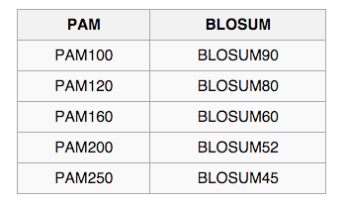
PAM vs BLOSUM
General Use
PAM 120
BLOSUM 62*
Closely Related Species
PAM 60
BLOSUM 80
Distantly Related Species
PAM 250
BLOSUM 45
*BLOSUM 62 – used by BLAST – computed by choosing blocks of local alignments more than 62% identical

Slide 25
Needleman-Wunsch Algorithm – Nucleotide Alignment – Chap 3
Create N x M matrix
Place each sequence along one axis
Place score 0 at the up-left corner
Fill in 1st row & column with gap penalty multiples
Fill in the matrix with max value of 3 possible moves:
Vertical move: Score + gap penalty
Horizontal move: Score + gap penalty
Diagonal move: Score + match/mismatch score
The optimal alignment score is in the lower-right corner
To reconstruct the optimal alignment, trace back where the max at each step came from, stop when hit the origin.

Slide 26
Needleman-Wunsch Algorithm – Protein Alignment – Chap 5
Create N x M matrix
Place each sequence along one axis
Place score 0 at the up-left corner
Fill in 1st row & column with gap penalty multiples
Fill in the matrix with max value of 3 possible moves:
Vertical move: Score + gap penalty
Horizontal move: Score + gap penalty
Diagonal move: Score + match/mismatch score
The optimal alignment score is in the lower-right corner
To reconstruct the optimal alignment, trace back where the max at each step came from, stop when hit the origin.

Slide 27
Needleman-Wunsch Algorithm – Protein Alignment – Chap 5
Create N x M matrix
Place each sequence along one axis
Place score 0 at the up-left corner
Fill in 1st row & column with gap penalty multiples
Fill in the matrix with max value of 3 possible moves:
Vertical move: Score + gap penalty
Horizontal move: Score + gap penalty
Diagonal move: Score + match/mismatch score
The optimal alignment score is in the lower-right corner
To reconstruct the optimal alignment, trace back where the max at each step came from, stop when hit the origin.

Slide 28
Needleman-Wunsch Algorithm - Protein Alignment – Chap 5
Create N x M matrix
Place each sequence along one axis
Place score 0 at the up-left corner
Fill in 1st row & column with gap penalty multiples
Fill in the matrix with max value of 3 possible moves:
Vertical move: Score + gap penalty
Horizontal move: Score + gap penalty
Diagonal move: Score + match/mismatch score from substitution matrix
The optimal alignment score is in the lower-right corner
To reconstruct the optimal alignment, trace back where the max at each step came from, stop when hit the origin.
Notes:
Come up with set of questions to be completed in class

